Slide 1
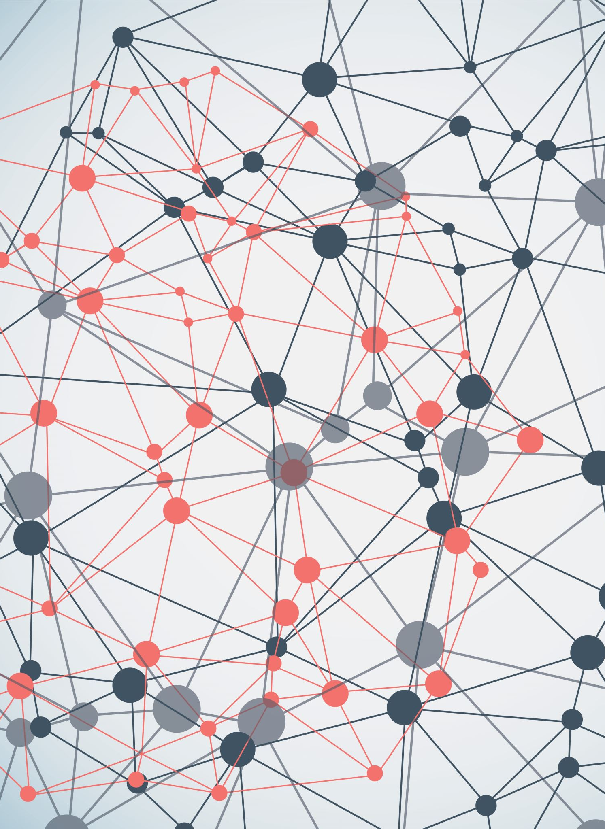
Introduction to Deep Learning
Jawwad A Shamsi
Dean FAST NUCES
CEO http://syslab.ai & http://iParhai.com
Jawwad.shamsi@nu.edu.pk

Slide 2

About myself
Dean FAST NUCES
iParhai (startup)
Previously
Director Campus
HoD Computer Science
Education
PhD. Computer Science
Wayne State Univ, MI, USA

Slide 3
Topics
Introductory Lecture on Deep Learning
AI vs ML DL
Features
Neural Networks
Activation Functions
MLP
Applications
Types of DNNs
Hands-on

Slide 4
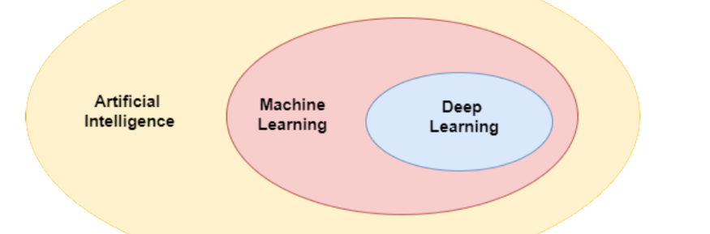
AI vs ML and DL
AI: Train Machines so they mimic humans
ML: A subset of Artificial Intelligence that uses statistical learning algorithms. Has the ability to automatically learn and improve from experiences
DL: Subset of ML. Feature selection is integrated with classification.

Slide 5
ML vs Programming
Input
Conventional Computer
Output
Program
Input
Machine Learning
Program
Output

Slide 6
Features
Set of independent variables
Learned to predict the outcome

Slide 7
Example of Features
Predict the Grade ?
No. of lectures attended
No of Hours of Self Study
Previous CGPA

Slide 8
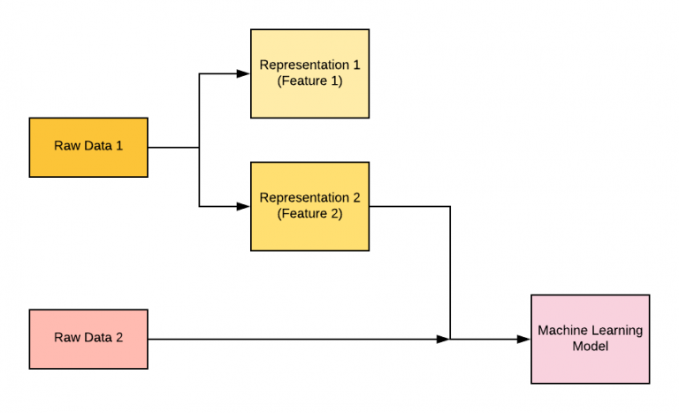
Features

Slide 9
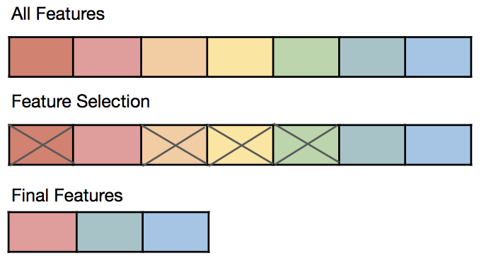
Feature Selection

Slide 10
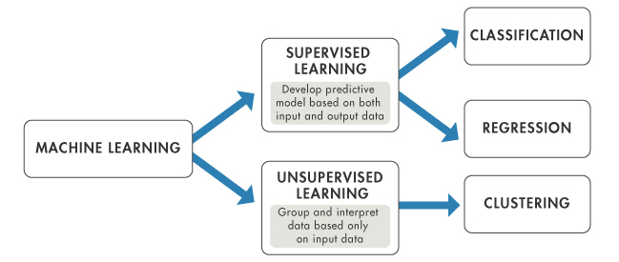
Overview of ML

Slide 11
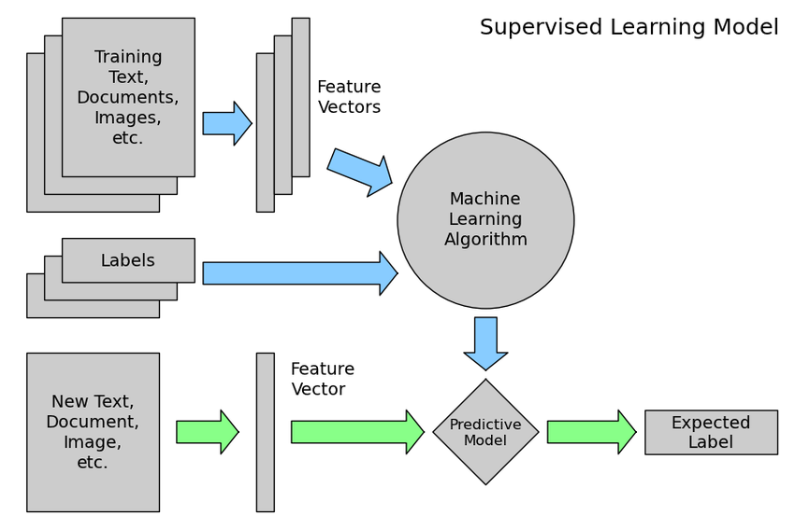
Classification ML Pipeline
Pre-process data
Extract Features (Attributes) on the basis of which a label can be predicted
Develop rules (Train)
Evaluate rules (Test)
Iterate between 3 and 4

Slide 12
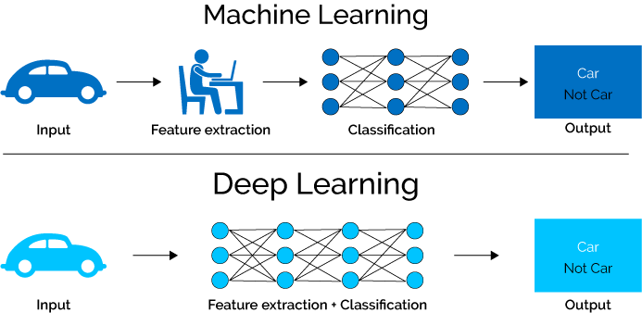
Deep Learning Pipeline
In DL, there is no dedicated process of feature extraction. It is bundled with classification

Slide 13
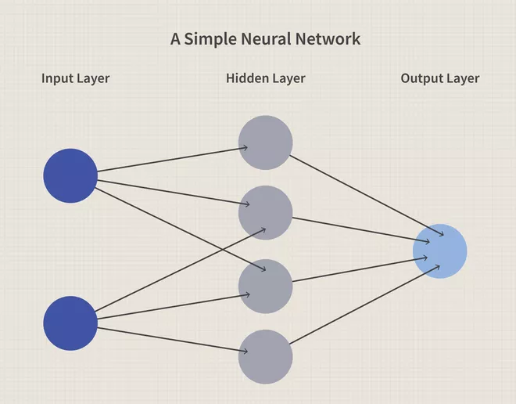
Neural Network
Hidden layer: Non-linear
transformations
Input layer: Features
Output Layer: Predictor Variable
image source: Investopedia.com

Slide 14
Why Non-Linear Transformations
Most of the data relationships are non-linear

Slide 15
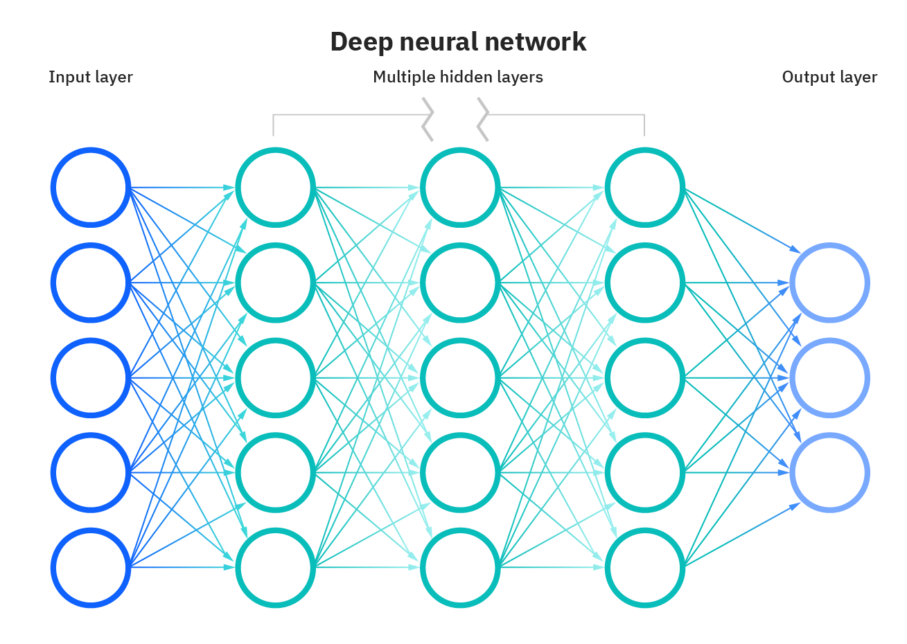
Deep Neural Network

Slide 16
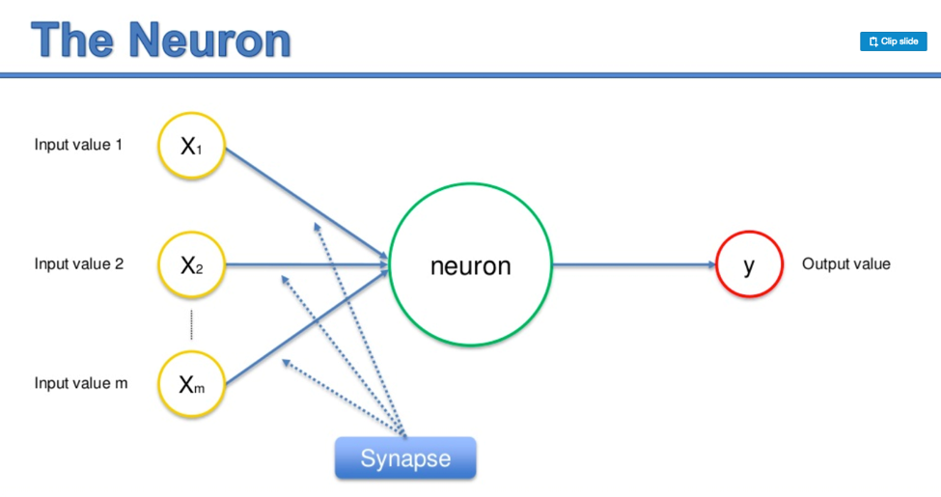
Neuron
Neuron is a smallest unit of
Computation
Takes weighted sum of inputs
Applies activation function
Computes output

Slide 17
Activation Function
Mimics biological Neuron
Transforms an input to output

Slide 18
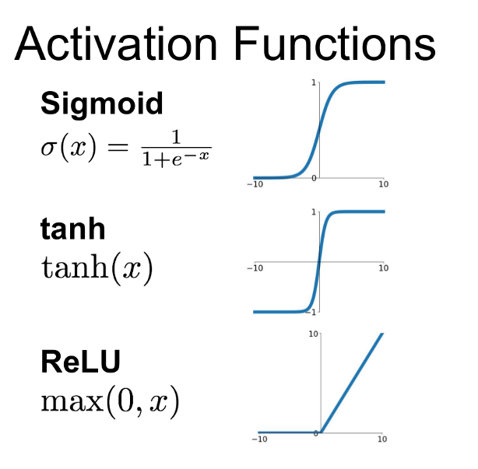
A few Activation Functions

Slide 19
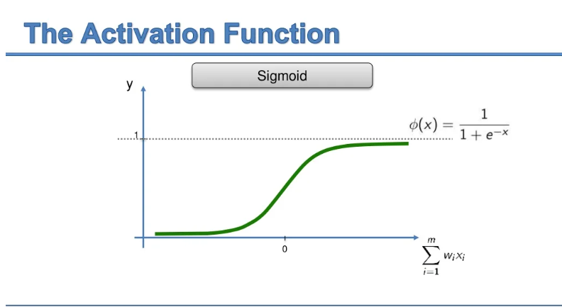
Sigmoid Activation Function

Slide 20
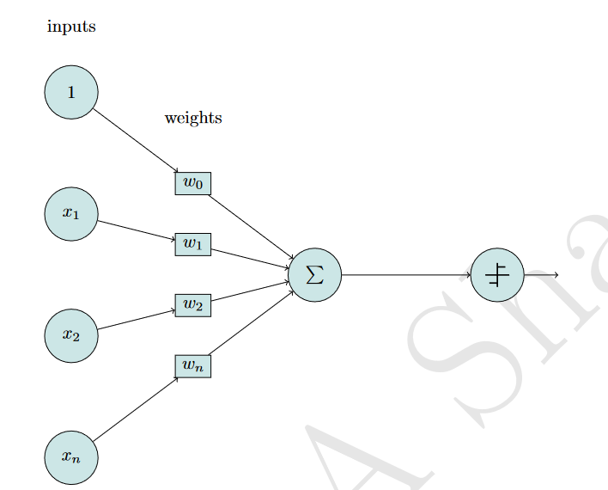

Neuron (Weighted Sum +Activation)
$$Z=ActivationFunction(w1x1+w2x2+{w3}^{}x3+b)$$
b$=bias=(w0.1)$

Slide 21
Neuron
Takes the input signals
Computes the weighted sum of the inputs
Applies a step function
Checks whether to trigger an output if the threshold exceeds a limit.

Slide 22
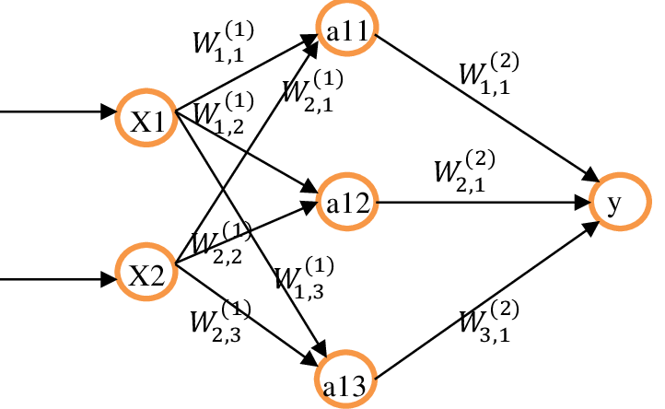
Output of DNN
Forward Propagation

Slide 23
How to get it right
Prediction is accurate?

Slide 24
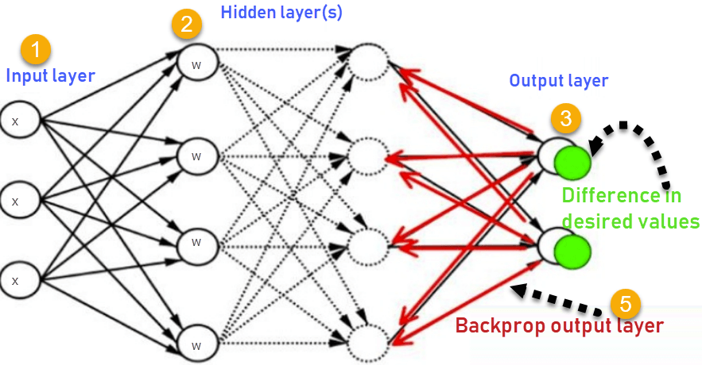
Back Propagation
Move backwards
Adjust weights

Slide 25
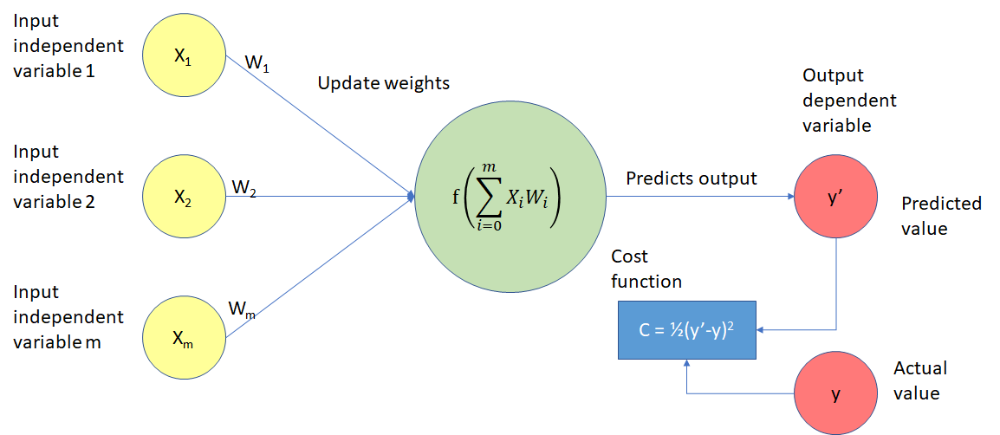
Cost Function

Slide 26
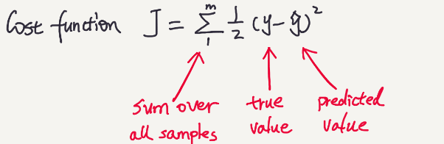
Cost Function

Slide 27
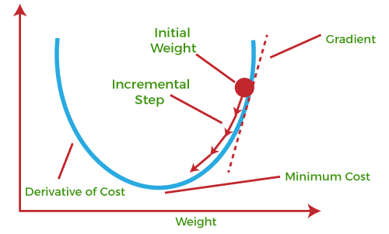
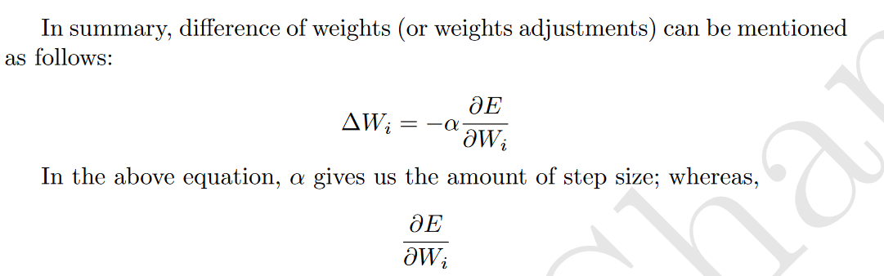
How to minimize the error

Slide 28
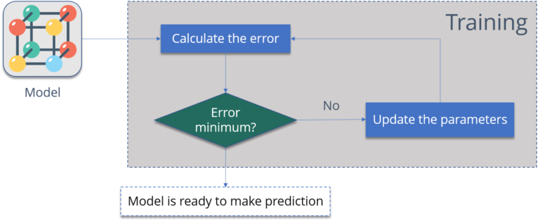
Training

Slide 29
Different Types of Deep Neural Networks and Applications

Slide 30
Application | Examples | Type of DNN
Sequence Learning | Machine Translation Sentiment Analysis Natural Language Processing | RNN LSTM GRU Transformers
Image Processing | Cancer Diagnosis Cat or Dog | Convolutional Neural Network
Object Detection | Search Engines | Modification of CNN (Yolo)
Autonomous Car | Driverless cars Robots | Reinforcement Learning
Deep Fake | Determination of outlier and anomaly. Creation of peer groups of machines and users. | Generative Adversarial Networks
Classification | Malware Other Classification Examples | Multi-Layer Perceptron

Slide 31
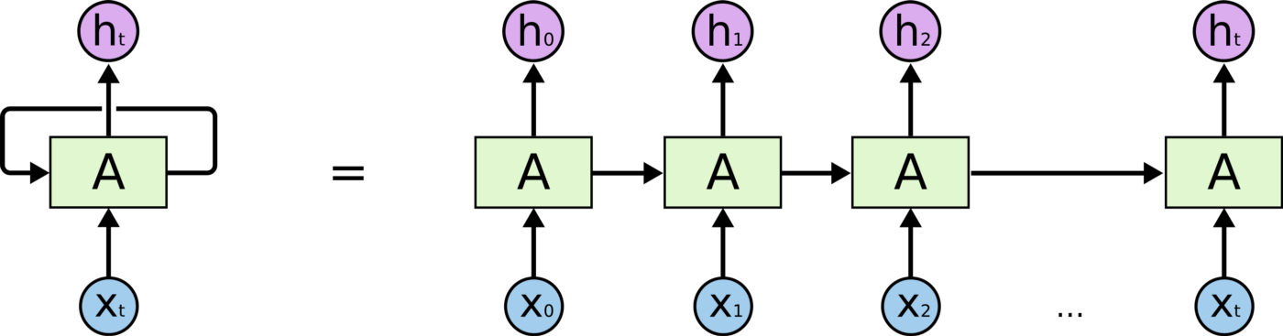
Sentiment Analysis using RNN
The food was good, not bad at all
The food was bad, not good at all

Slide 32
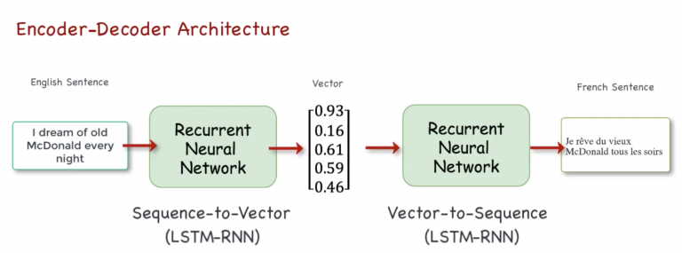
Machine Translation

Slide 33
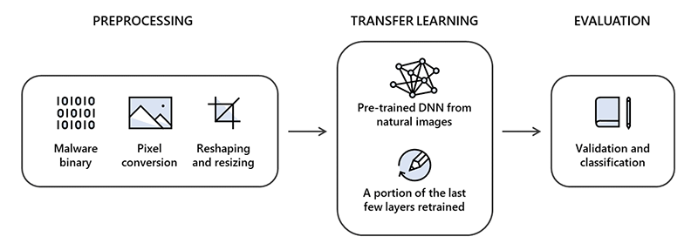
Malware Classification
Malware files are converted to images
Features are extracted using CNN
Classify a software as benign or malware

Slide 34
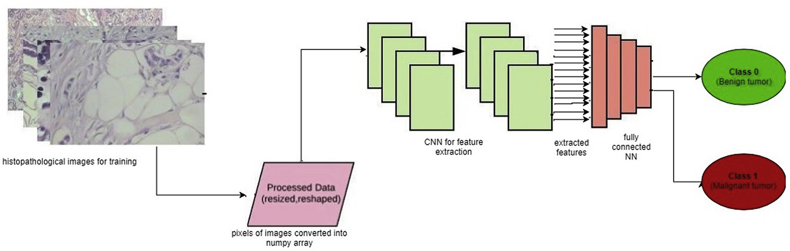
Cancer Diagnosis using CNN

Slide 35
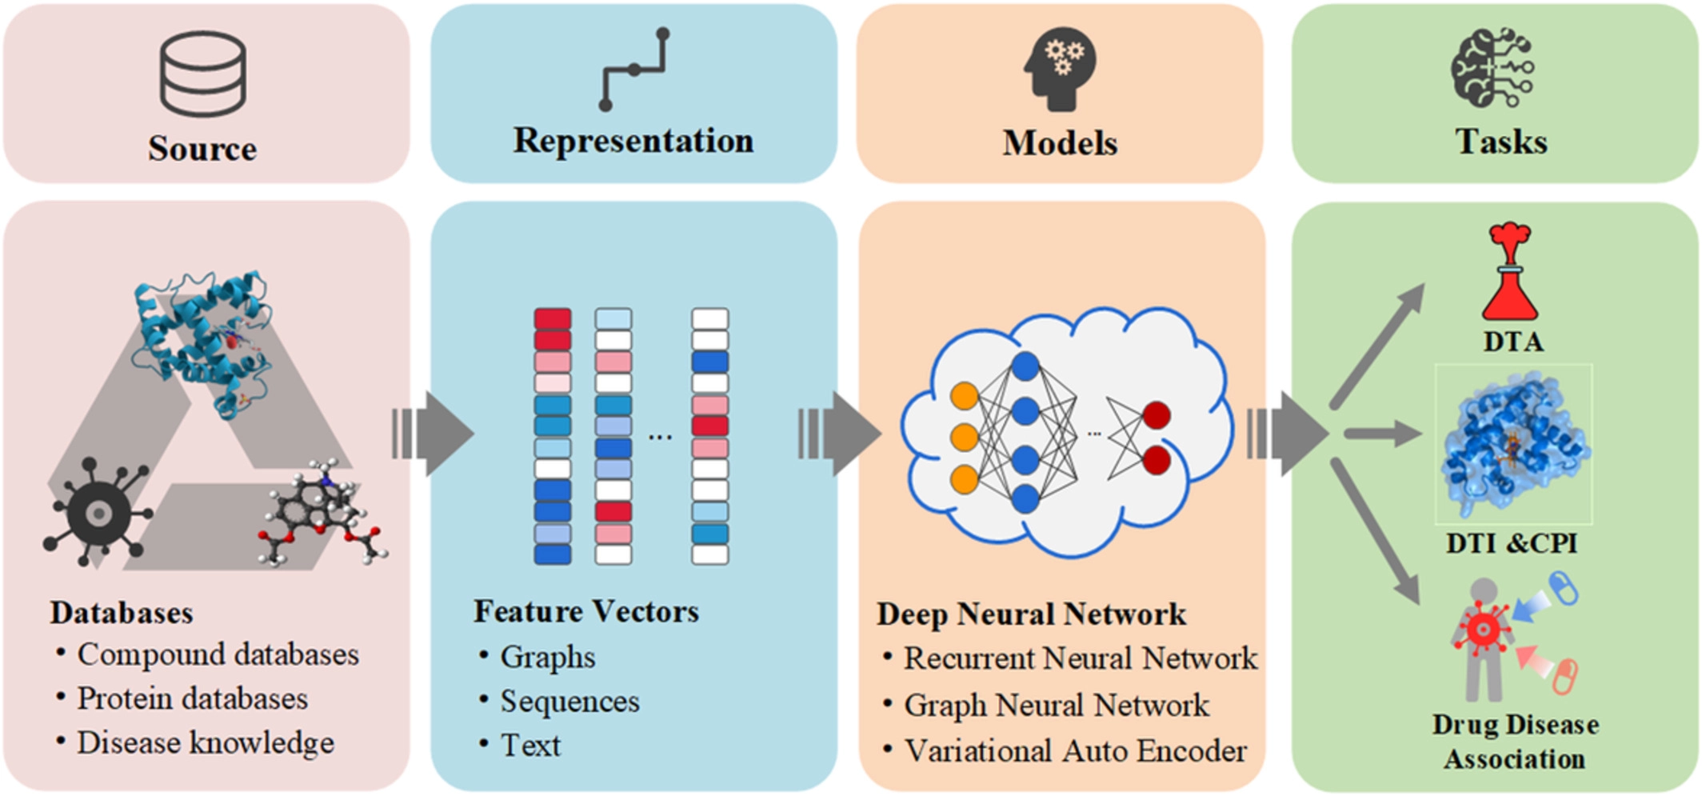
Drug Repurposing

Slide 36
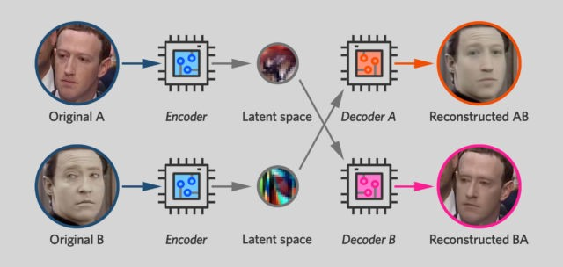
Deepfake

Slide 37
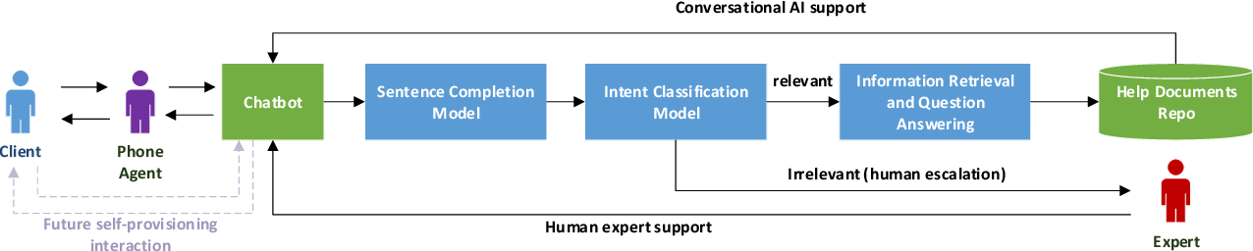
Chatbot

Slide 38
Conclusion
Emerging Area
Lots of Opportunities and Challenges

Slide 39
Hands-on Training

Slide 40
And Gate
https://tinyurl.com/paews
Modify it for OR gate or reduce hidden layers

Slide 41

Questions
Jawwad.shamsi@nu.edu.pk

