Slide 1
Competitive Advantage for Pakistan through Research & Development in Engineering & Technology

Slide 2
1. Phases of Industrial Growth in West

Slide 3
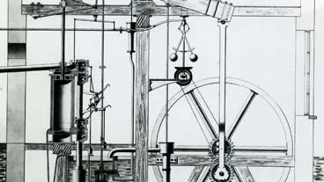
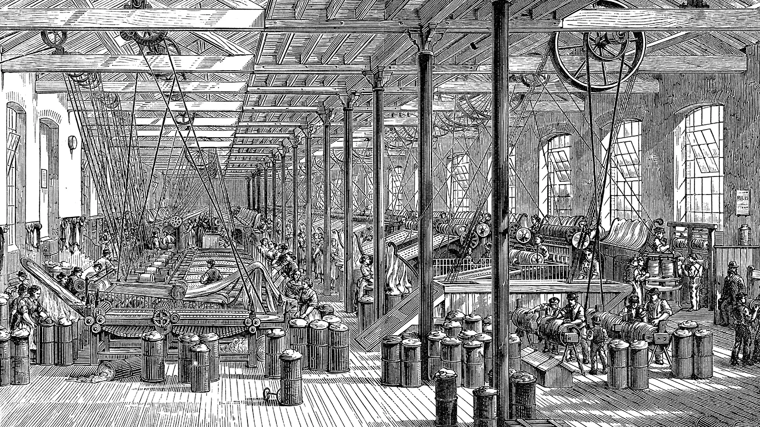
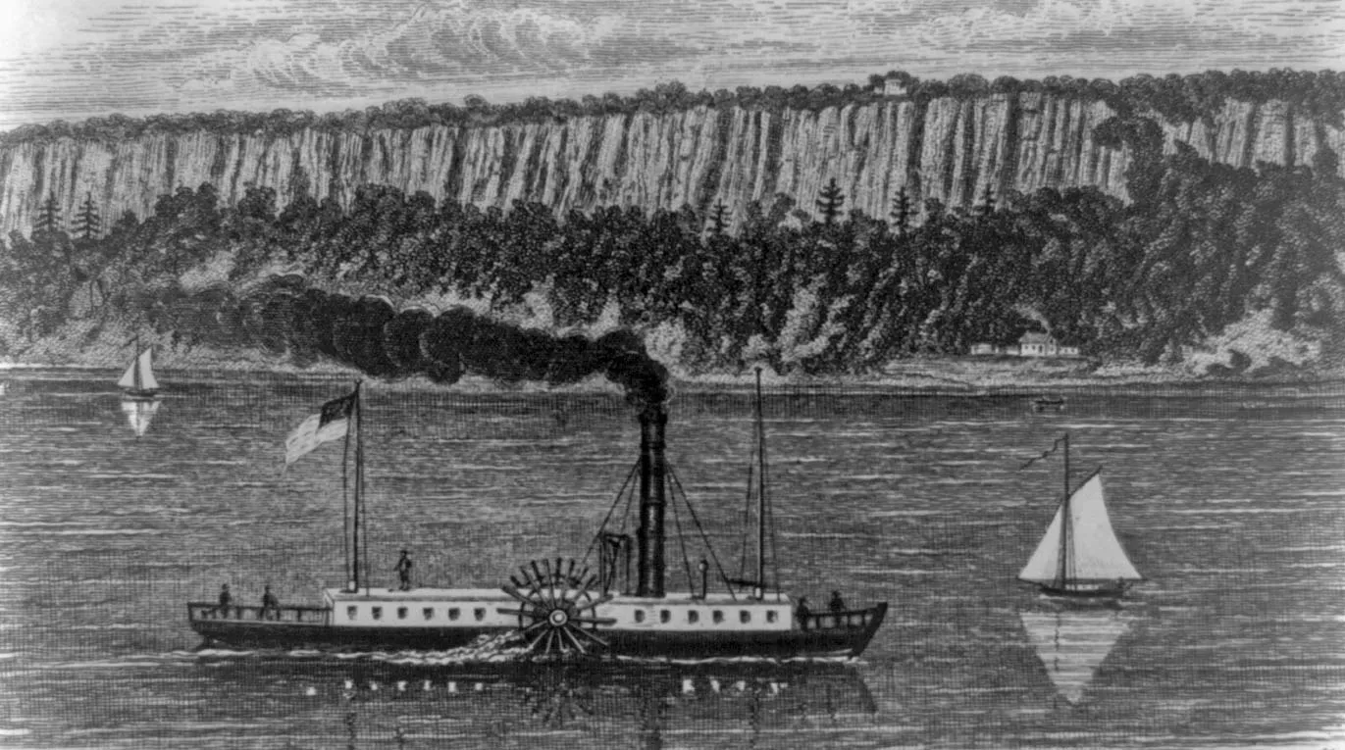
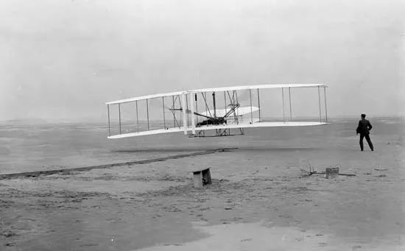
Industrial Revolution

Slide 4
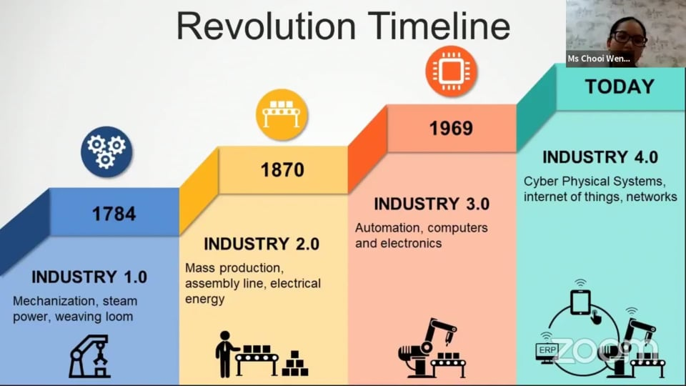
Phases of Industrial Revolution

Slide 5
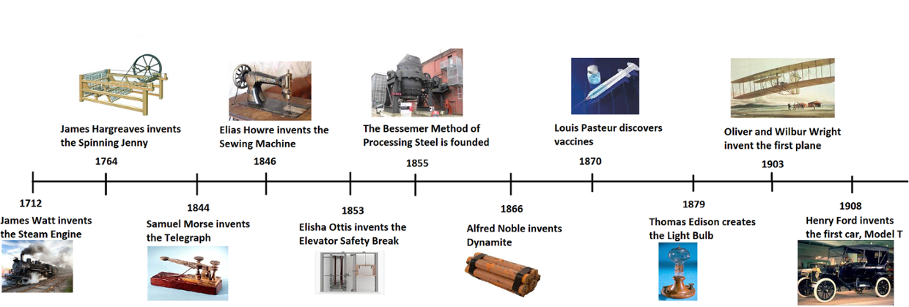
Developments in the First Wave of Industrial Revolution

Slide 6
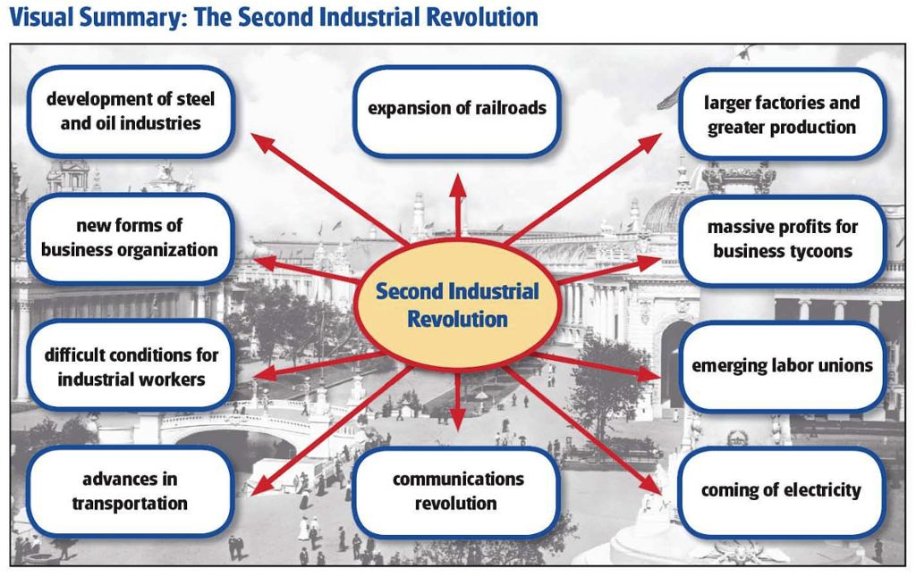
Developments in the Second Wave of Industrial Revolution

Slide 7
Developments in the Third Wave of Industrial Revolution
Global Communication
Automation
Globalization
  Cultural
  Economical
  Political
  Moving away from Carbon Economy
  Sustainability – Triple Bottomline
  What If There Was a 3rd Industrial Revolution_.mp4

Slide 8
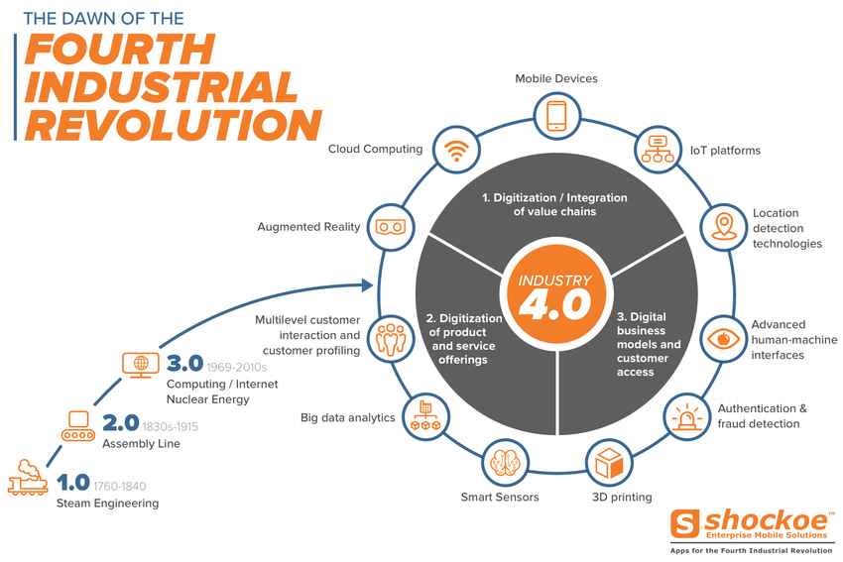
Developments in the Fourth Wave of Industrial Revolution
Aaaaaaaaaaaaa
aaaaaaaaaaaaa

Slide 9
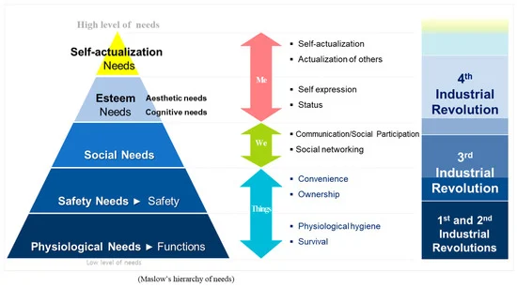
How Industrial Revolutions Impacted Us?

Slide 10
Challenges of Industrial Growth
Poor Working Conditions
Poor Living Conditions
Low Wages
Child Labor
Pollution
Social Changes & Pressures
Stress & Psychological Problems
Health Issues
Fast Paced Changes in Lifestyle
International Work Environment
Derailment
Privacy Issues
Ethical Dilemmas
White Collar Crimes
Corporate Cartels
Practices of Financial Institutions
Mega Cities
  High Urbanization Rate
  Stress on Infrastructure
  Complications in Management
  High Crime Rates

Slide 11
2. Concepts of Competitive and Comparative Advantages of Nations

Slide 12
Sources of Competitive Advantage
People. People are the driving force behind most competitive advantage. ...
Organizational Culture & Structure. ...
Processes & Practices. ...
Products & Intellectual Property. ...
Capital & Natural Resources. ...
Technology

Slide 13
3. Recent Example of Economic Growth – China & Bangladesh

Slide 14
Phases of Economic Development of China
The Agriculture Reforms
Township and Village Enterprises
The Textile Revolution
Skill Enhancement of Labors
Overseas Education Programs
Shift to Electronic Economy
The Copycat Culture
The Global Factory
Formation of Conglomerates
Linking Economy with Global Trade

Slide 15
Economic Development in Bangladesh
Rising Middle Class
Inclusion of Women in Workforce
Microfinancing
Socially Inclusive Education System
Better Health Care Facilities
Technological Advancements
Investment in infrastructure
Export-Led Growth
Foreign Remittances
Monolithic Culture

Slide 16
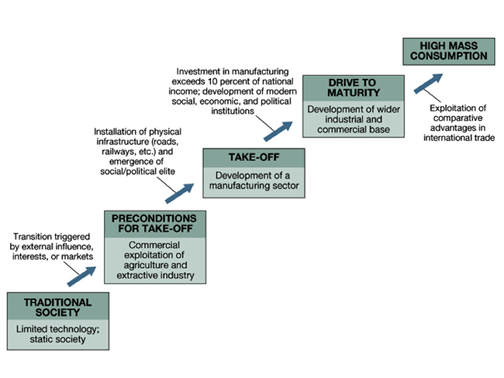
Rostow’s Stages of Economic Growth

Slide 17
4. Issues & Challenges in the Economic Growth of Pakistan

Slide 18
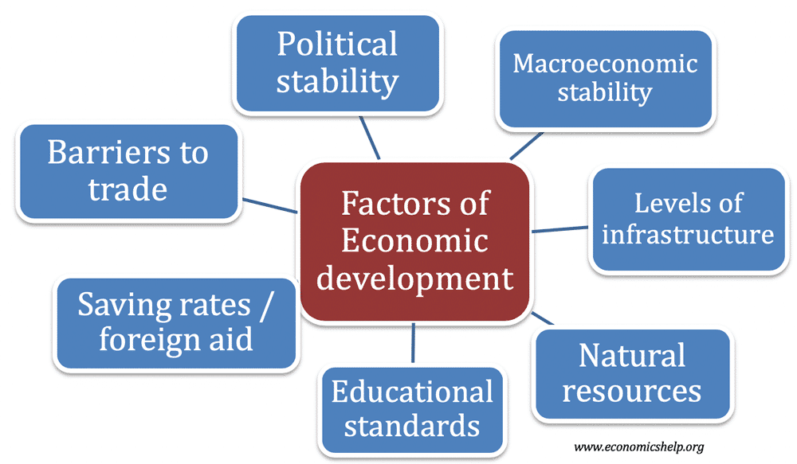
Factors of Economic Development
aaaaaaaaaaaa

Slide 19
5. The Winning Way for Pakistan

Slide 20


Slide 21
Global Innovation Index - Top Five Countries
Country Per Capita Income % World Per Capita GDP Income Income Rank Rank
Switzerland (Number 1 in 2020) $80,296 388% 9 17
Sweden (2) $54,075 301% 20 22
United States of America (3) $59,939 350% 13 1
United Kingdom (4) $39,532 263% 26 5
Republic of Korea (10) $29,958 227% 36 10
99. Pakistan &01,285 090% 160 40

Slide 22
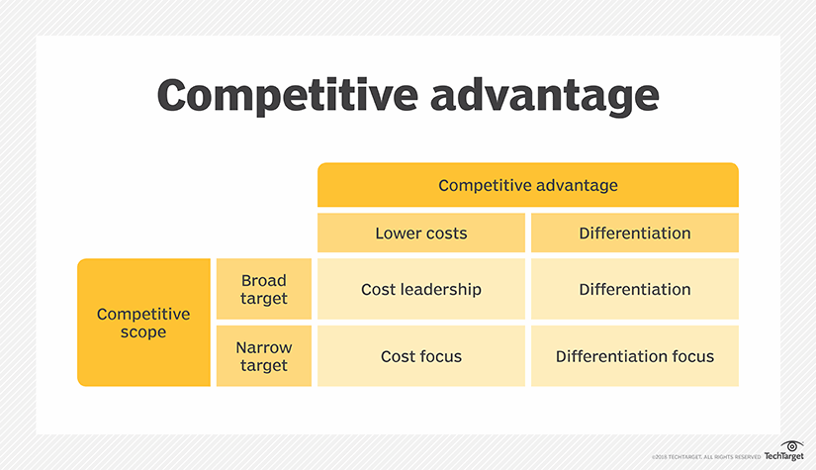
Strategies for Competitive Advantage
aaaaaaaaaaaaaaa

Slide 23
The Winning Way for Pakistan
Vigilant Management of Economic Development Phases by Government
Active Participation of Stakeholders in the Economic Development Programs
National Efficiency Management Program
Integration of Supply Chain
Investment in International Commercial Relationships
Enforcement of Contracts
Culture of Entrepreneurship
Facilitation in Scaling Up
Withdrawal of Subsidies after Infant Period
Let Competitive Advantage be Dynamic
National Research Centres on Commercial Basis
Deregulation and Minimum Government Intervention
Privatization
Savings & Investments

Slide 24
Discussions
&
Questions

