Slide 1

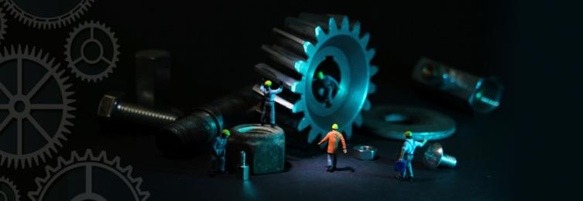
Address: E 6/1, Block 7, Gulshan-e-Iqbal,
Karachi, Pakistan
Website: http://www.pacadengg.org
Tel: +92-21-34831726
Fax: +92-21-34182105

Slide 2
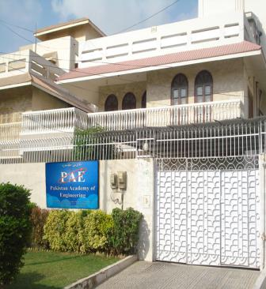
Pakistan Academy of Engineering – PAE
The Pakistan Academy of Engineering is qualitatively the apex body of the Engineering Community of Pakistan, structured in line with the international practice. It has secured international status by getting elected as a member of the International Council of Academies of Engineering & Technological Sciences (CAETS). Pakistan is the only Muslim Country represented on the Council.
We are a learned society and a thinking laboratory of the country’s engineering community, established in 2013. We have been certified by the Pakistan Centre for Philanthropy as NPO and subsequently granted NPO status by the FBR. The minimum qualification of our fellows is a Ph.D. in Engineering in order to ensure quality in the conduct of our business.

Slide 3
Objectives of PAE
To pursue, encourage and maintain excellence in the entire field of engineering in order to promote the advancement of the science, art and practice of engineering for the benefit of the Pakistani nation.
To provide national forum for the discussion of engineering and technological issues.
To promote the application of emerging technologies for the benefit of Pakistani nation.
To promote independent advice on issues of engineering and technology that underly many questions of national importance.
To promote the technological welfare of the nation by utilising the knowledge and insight of eminent members of the engineering profession.
To bring together the country’s most eminent engineers from all disciplines and identity strategic priorities to enhance Pakistan’s engineering capabilities and to lead debate by guiding informed thinking and influence public policy.
To promote network of highly experienced and competent professionals in the field of engineering, who seek to stimulate contacts between disciplines and across national borders.
To advise the Government and also conduct its own independent studies that examine important topics in engineering and technology.
To engage more efficiently with the public and public policy process. To encourage cooperation with international engineering efforts.
To interact with the professional bodies in engineering and scientific academies in Pakistan and abroad.
To promote strengthening and integration of academia, industry, government and society in the country.
To promote creation of engineering culture in the country.
To honour outstanding engineers of the country, encourage their innovations and institute awards in recognition of their extraordinary contribution to the engineering profession in education, management, research, practice and overall impact on the society.
To institute and establish Professorship, Studentships, Scholarships, Awards and other Benefactions.
To function as initiator, catalyst, coordinator and opinion moulder.
To run the society on non-political, non-commercial and non-religious basis.
The society shall run purely on charitable basis.

Slide 4






























CAETS MEMBER COUNTRIES
ARGENTINA
AUSTRALIA
BELGIUM
CANADA
CHINA
CROATIA
CZECH REPUBIC
DENMARK
FINLAND
FRANCE
GERMANY
HUNGARY
INDIA
JAPAN
KOREA
MEXICO
NETHERLANDS
NEW ZEALAND
SOUTH AFRICA
NIGERIA
NORWAY
PAKISTAN
SERBIA
SLOVENIA
SWITZERLAND
UNITED KINGDOM
UNITED STATES
SPAIN
SWEDEN
URUGUAY

Slide 5
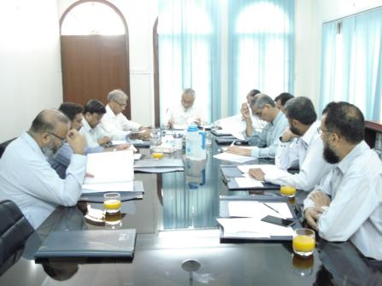
The Pakistan Academy of Engineering
Independent
Non-political
Non-governmental
Non-religious
Non-commercial
Democratic

Slide 6

Our Vision
To promote engineering and technological sciences in a planned manner to build sustainable competitive edge for Pakistan.

Slide 7
Our Values
Visibility
Sharing
Fairness
Independence

Slide 8
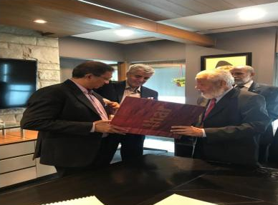
How PAE Works?
Elected President
Assembly of Fellows
Elected Council
Focused Peer Committee
Prudently Inducted Fellows
A Networked Outreach Committee
Bottom-Up Decision-Making Approach

Slide 9
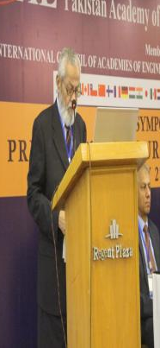
Profile of the President
Dr.–Ing. Jameel Ahmad Khan
Vice Chancellor of the NED University of Engineering and Technology
(March 01, 1987 to November 19, 1991)
Chairman, Pakistan Engineering Council
  First Term (1997-1999)
  Second Term (2000-2002)
President, Pakistan Chamber of Engineers
  First Term (1997-1999)
  Second Term (2000-2002)
Member, Executive Committee, Asian Fluid Mechanics Congress
Chairman, Pakistan Desalination Association
(1997-2000)
President, Pakistan Academy of Engineering
(December 20, 2013 - December 20,2022)

Slide 10
Our
Major
Activities

Slide 11
Symposia
2015
Prospects of E-Mobility in Karachi
Engineering and Health Care Nexus in Pakistan
Industrial Renaissance & Competitiveness for Pakistan
Drinking Water
2016
5. Coal-to-Liquids Technology for Pakistan
6. Additive Manufacturing
2017
7. Innovative Thar Coal Value Chain
8. Hydrogen, Carbon-Free-Fuel, Democratizing the Energy
9. Cyber Security- Where do We Stand?
2018
10. Prospects for Mini Nuclear Power Plants in Pakistan
11. Our Mineral Resources- The Most Neglected Sector
2019
12. Bioeconomy & Engineering Nexus
13. Water Stress
14. Preparing for Our Digital Economy
15. The Future of Engineering in Pakistan
Upcoming
16. Climate change and Capture of CO2
17. Emerging Technologies

Slide 12
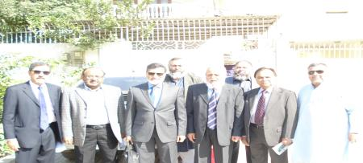
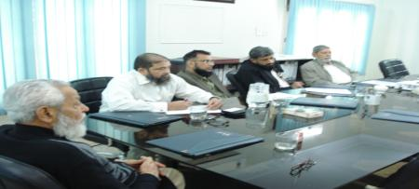
Knowledge Forum
Wireless Power Transfer – Application in Hybrid – Electric Vehicles
Digital Transformation
Advances in the Engineering Education
Wind Farming in Pakistan
Dematerialization and its impact on Industry
Future of Engineering Education
Business Strategy for Engineering Organizations in Pakistan
Materials Science and Engineering of Epoxy Based Composites
Ultra High-Performance Concrete-UHPC
Identity Access and Management
Upcoming
Plant Asset Management

Slide 13
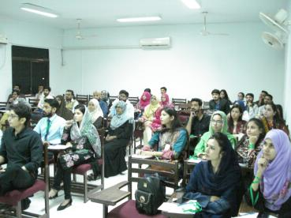
Workshops
Technology Assessment for Organizations
Knowledge Creation and Management for Sustainable competitive Advantage
Conducting Technology Impact Assessment
Upcoming
Blockchain
Parameters of Technology Transfer
Assessing Data and Information Quality

Slide 14

Upcoming Workshops
Block chain

Slide 15

Research Studies
Preliminary feasibility Study on “Thar Coal Utilization” with the collaboration of The institute of Applied Energy, Japan.
A study on “Effective Utilization of Thar Coal” in association with JCOAL, Japan. The study was funded by Ministry of Economy, Trade and Industry (METI), Japan.

Slide 16
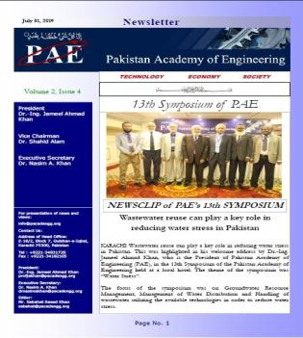
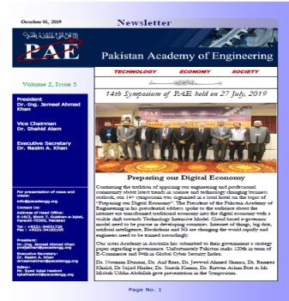
We Keep You Updated:
Our News-Letters

Slide 17
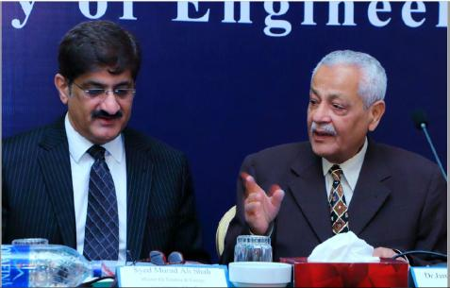
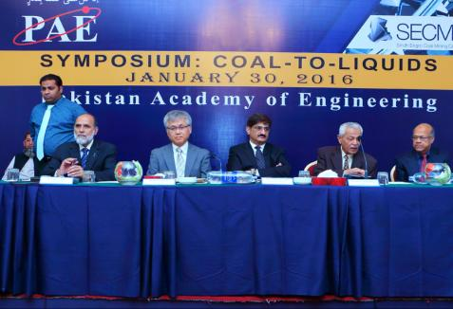
Some Glimpses of PAE Activities

Slide 18
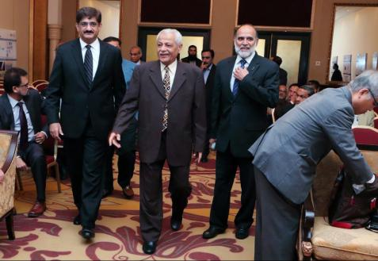
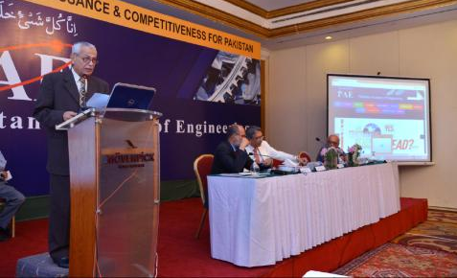

Slide 19
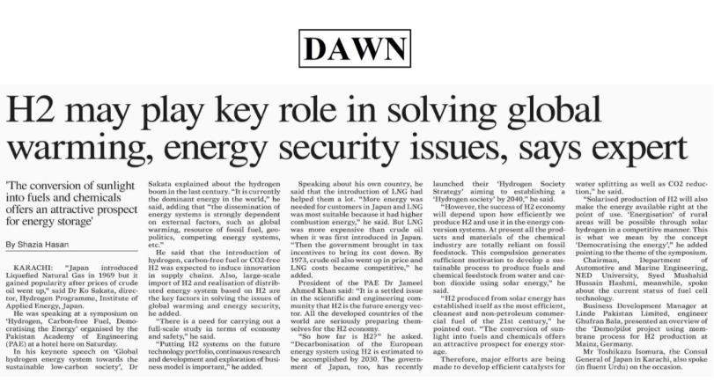
Newspaper Coverage of PAE

Slide 20

Our Future Programmes
Establishment of Advanced Engineering Research Centers
Promotion of Certification Programs for Engineers to Enhance Their Employability
Expansion of Outreach
Investment in Market-Based Training
Sponsoring of Surveys and Programmes

Slide 21
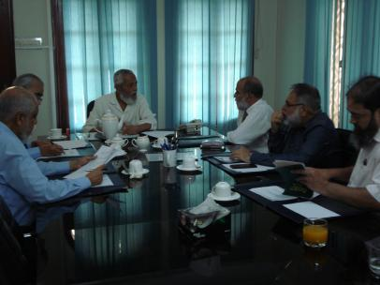
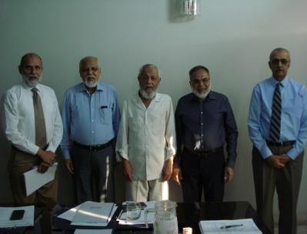
PAE – Endowment Fund

Slide 22
L IST OF FELLOWS OF
THE PAKISTAN ACADEMY OF ENGINEERING
Sr. | Name | Address | Cell | E-mail
1 | Dr.-Ing. Jameel Ahmad Khan | E-6/1, Block 7, Gulshan-e-Iqbal, Karachi 75300 | 0345-2590349 | profjakhan@yahoo.com
2 | Dr. Nasim A. Khan | S.U. House No. 564, Askari V, Malir Cantt., Karachi. | 0300-8564625 | drnasimakhan@gmail.com
3 | Dr. Afzal Haque | 110/11, Saba Avenue, Phase VI, DHA, Karachi. | 0334-5099131 | afzal_haque@hotmail.com
4 | Dr. Khan Gul Jadoon | Professor Mining Engineering, Balochistan University of Information Technology, Engineering and Management Sciences (BUITEMS) OLD: Director, CIIT, Abbotabad | 0333-9109693 | khan.gul@buitms.edu.pk kgjadoon@gmail.com kgjadoon@ciit.net.pk
5 | Dr. Haroon Jangda | Shaheen Castle Apartment # 202, Plot No. 141, Sharfabad Road No.10, Behar Muslim Coop. Housing Society, Karachi. | 0300-3565850 | aamirjangda786@yahoo.com duetkhi@yahoo.com
6 | Dr. Shahid Alam | 92/IV, Roomi Str. Phase VIII, DHA, Karachi. | 0300-2017110 | dsa@exponent.com.pk
7 | Dr. Salimuddin Zahir | House No. 457, Str. 64, Sector-0-9, Pakistan Town, Phase-I, Islamabad-44000 | 0323-8556044, 0320-8556044 | zahirsalimuddin@gmail.com cfdpak@apollo.net.pk
8 | Dr. Abid Karim | Fl-11/1/7, Block-6, Gulshan-e-Iqbal, Karachi. | 0333-3244340 | akarimpk@yahoo.com akarim@uit.edu
9 | Dr. Ajmal I. Ansari | 346 Torrington Dive West Canton, Ml 48188, USA | 1-734-516-3765 | ajmal@lycos.com
10 | Prof. Dr. Ashraf Ali Meo | Topi (23640), District Swabi Khyber Pakhtunkhwa, Pakistan | 0334-3551979 | drashraf@giki.edu.pk
11 | Dr. Noorullah Soomro | Flat No. 3, Lady Sughra Hidayat Mahal, Near Rimpa Plaza, M.A. Jinnah Road, Karachi. | 0333-2150840 | nssoomro@hotmail.com
12 | Prof. Engr. Dr. Syed Muhammad Usman Ali | Electronic Engineering, NED UET., Karachi. | 0336-1815723 | uashah68@hotmail.com uashah68@gmail.com uashah68@neduet.edu.pk

Slide 23
L IST OF FELLOWS OF THE PAKISTAN ACADEMY OF ENGINEERING continued…
Sr. | Name | Address | Cell | E-mail
13 | Engr. Dr. Zia Mohy-Ud-Din | Biomedical Engineering Department, Sir Syed University of Engineering & Technology, Karachi. | 0333-3025025 | ziaofkun@gmail.com
14 | Dr. Abdul Azim Akbar | 168, 11th Central Street, Phase 2, DHA, Karachi. | 0303-9121867 | azim.akbar@gmail.com
15 | Dr. Irfan Ahmad | Department of Electronic Engineering, NED University of Engg. & tech. Karachi. | 0332-3803926 | irfans@neduet.edu.pk
16 | Dr. Muhammad Imran Aslam | Department of Electronic Engineering, NED University of Engg. & tech. Karachi. | 0334-1027474 | iaslam@neduet.edu.pk
17 | Prof. Muhammad Hasan Imam | Civil Engineering Department, Umm Al-Qura University, Makkah, Saudi Arabia | 96657638302 | Imam.uqu@gmail.com
18 | Prof. Dr. Syed Ali Rizwan | Professor & Head of Structural Engineering Department, NUST | 0334-4255188 | syedalirizwan@hotmail.com
19 | Dr. Arshad Aziz | 2nd Floor, Haq Manzil # 1, A-60/8, Lane # 2, Delhi Colony # 1, off Ch. Khaliq-uz-Zaman Road, Clifton, Karachi-75600 | 0333-2228300 | arshad@nust.edu.pk
20 | Dr. Mukkarum Husain | House No. 6/17, Sector 5D, North Karachi, Karachi. | 0315-2571959 | mrmukkarum@yahoo.com
21 | Dr.-Ing. Syed Mushahid Hussain Hashmi | Professor / Chairman, Department of Automotive & Marine Engineering, NEDUET | 0300-2115544 | camd@neduet.edu.pk
22 | Dr. Maaz Akhtar | Assistant Professor, Mechanical Engineering Department, NEDUET | 0321-2049130 | maaz@neduet.edu.pk
23 | Dr. Ahmad Hussain | Director ORIC (Office of Research, Innovation & Commercialization), SZABIST | 0323-2723411 | dir.oric@szabist.edu.pk ahmad.hussain@szabist.edu.pk ahmadutm@gmail.com
24 | Dr. Muhammad Fahad | Assistant Professor, Industrial & Manufacturing Engineering Department, NEDUET | 0331-2609826 | mfahad@neduet.edu.pk

Slide 24
L IST OF FELLOWS OF THE PAKISTAN ACADEMY OF ENGINEERING continued…
Sr. | Name | Address | Cell | E-mail
25 | Prof. Dr. Abdul Rehman Memon | Rector, Newports Institute of Communication and Economics B-28, 13-D, Gulshan-e-Iqbal, Karachi (Home Add) | 0321-2977650 | armemon2001@yahoo.com
26 | Prof. Dr. Hasina Khatoon | Professor and Director, (Karachi Campus), FAST-NU | 0334-3417571 | hasina.khatoon@nu.edu.pk
27 | Dr. Syed Nazeer Alam | Dean, Electrical Engineering , National University of Sciences & Technology | 0346-2457974 | nazeer@pnec.nust.edu.pk
28 | Prof. Dr. Syed Jawaid Askari | Chairman R&D Committee, Department of Mechanical Engineering, Islamic University of Medina, Prince Naif Ibn Abdulaziz, Al Jamiah, Medina 42351, Saudi Arabia | 966562487121 | drjawidaskari@gmail.com
29 | Prof. Dr. Hafeez ur Rahman Memon | Meritorious Professor / Dean Faculty of Engineering, Mehran University of Engineering & Technology, Jamshoro | 780 709-6487 0333-2616547 | hurmemon@gmail.com
30 | Dr. Engr. Shuaib Ahmad | Civil and Structural Engineering Consultants Head Office: 135-C Commercial “B” Market Phase 2 Defence, Karachi. | 0335-3388180 | Zenith.international1234@gmail.com
31 | Dr. Abdul Samad Khan | H # B-82, Block # 10, Gulshan-e-Iqbal, Karachi - 75300, Pakistan. | 0345-2745509 | dr_askhan@yahoo.com
32 | Dr. Mohammad Usama Siddiqui | Asst. Professor Dept. of Mechanical Engineering, DHA Suffa University | 0333-1299985 | musiddiqui@gmail.com musiddiqui@dsu.edu.pk
33 | Dr. Bilal A. Siddiqui | PAC KAMRA, Airforce Avaition Deisgn Institute, Pakistan Areonotical Complex, KAMRA, Punjab | +92-335-3461598 | Airbilal@gmail.com airbilal@dsu.edu.pk
34 | Dr. Muhammad Nauman Qureshi | H # E-133/2, 1st Floor, Block-7, Gulashn-e-Iqbal, 75300, Karachi, Pakistan. | 0335-2411894-5 | mnaumanqureshi@gmail.com

Slide 25
L IST OF FELLOWS OF THE PAKISTAN ACADEMY OF ENGINEERING continued…
Sr. | Name | Address | Cell | E-mail
35 | Dr. Syed Abdul Moiz | Department of Electrical Engineering Faculty of Engineering & Islamic Arch. Umm-ul-Qura University PO Box: 5555, Makkah, Saudi Arabia | +96-56-773-9155 | sasyed@uqu.edu.sa drsamoiz@gmail.com moiz_pak@yahoo.com
36 | Dr. Muhammad Mahmood Ali | Room No. G-01, Faculty of Electrical Engineering, GIK Institute, Topi, Khyber Pakhtoon Khwa, Pakistan | 0332-5688608 | engrmahmoodnaz@gmail.com, m.ali@giki.edu.pk
37 | Dr. Muhammad Aamir | 04, Abdullah Mansion Bldg, Near Saeed Manzil, Jamila Street, M.A. Jinnah Road, Karachi - 74400 | +92-334-9222492 , +92-300-2115826 | muaamir5@yahoo.com muaamir5@gmail.com
38 | Engr. Dr. Yasar Amin | Professor, Department Telecommunication Engineering, University of Engineering and Technology Taxila, Punjab, Pakistan | 0347-786 7111 | yasar.amin@uettaxila.edu.pk
39 | Dr. - Ing. Imran J. Amin | Associate Professor & Head - Computer Science Department, SZABIST University D-258 KDA Scheme 1A, Karsaz, Karachi, Sindh, Pakistan | 0345-2087255 | amin.imran@gmail.com
40 | Dr. Jawwad A. Shamsi | Professor & Head, Deptt. of Computer Science FAST – NUCES Shah Latif Town (on National Highway), Karachi, Sindh, Pakistan | 0334-3661756 | jawwad.shamsi@nu.edu.pk
41 | Dr. Narmeen Zakaria Bawany | Chairperson, Assoc. Prof. Computer Science Dept. Jinnah University for Women A-118 KDA Officers Society, Karachi | 0333-3072699 | nshawoo@gmail.com
42 | Dr. Noman Uddin Yousuf | Assistant Prof., Automotive & Marine Engineering NED University of Engineering & Technology, University Road, Karachi, Sindh, Pakistan | 0300-2121104 | nyousuf@neduet.edu.pk
43 | Dr. Saqib Jamshed Rind | Assistant. Prof. Automotive & Marine Engineering NED University of Engineering & Technology, University Road, Karachi, Sindh, Pakistan | 0320-8872288 | sjrind@neduet.edu.pk
44 | Dr. Sohail Mahmood Qureshi | Structural Engineer, Pakistan Consulting Associates 88 H-1, Midway Street, Wapda Town, Lahore | 0333-4738172 | smqureshi2000@yahoo.com pcaengineers@gmail.com

Slide 26
L IST OF FELLOWS OF THE PAKISTAN ACADEMY OF ENGINEERING continued…
Sr. | Name | Address | Cell | E-mail
45 | Dr. Muhammad Imran Khan | Assistant Professor at GIK Institute House # 6/191 Sadar Bazar, Mandi-Bahauddin, Punjab, Pakistan | 0321-5289938 | imrankhan@giki.edu.pk, imran961137@hotmail.com
46 | Dr. Yasir Joya | House 165/F, Gulshan Ravi Scheme, Lahore-54000 Pakistan | 0345 4761716 | yasir.joya@outlook.com
47 | Engr. Prof. Dr. Ehsanullah Kakar | Vice Chancellor, Balochistan University of Engineering and Technology, Khuzdar Pakistan | 0344-4444782 | vc@buetk.edu.pk, drehsan.buitems@gmail.com
48 | Tariq Shamim | Engineering Building 226 A DeKalb, IL 60115 | N/A | tshamim@niu.edu
49 | Dr. Masroor Ahmed | R-46, Sumaira Bungalows Near Sufoora Chowrangi Gulzar-e- Hijri, Sector 34-A Scheme-33, Karachi, Pakistan. | 0333-2156760 | masroor46@gmail.com
50 | Dr. Shahid Qureshi | AMAN Center for Entrepreneurial Development IBA Main Campus, Karachi University. | 0324-2576637, 0301-8226596 | quresh.shahid@gmail.com, squreshi@iba.edu.pk
51 | Prof. Dr. Xiao-Guang Yue | No. 816 Dongfeng Avenue, Hanyang District, Wuhan City, Hubei Province, China; C2-2-3, Block 2, CBD Perdana 3,Persiaran Cyberpoint Timur, Cyber 12, 63000Cyberjaya, Selangor, Malaysia | +852 5607 9095 (Hong Kong China) | xgyue@whut.edu.cn; xgyue@foxmail.com; xgyue@whu.edu.cn; xgyue@ieti.net
52 | Dr. Mohammad Altaf Mukati | Vice President (Academics) & DEAN (Computing & Engineering Sciences) at Shaheed Zulfikar Ali Bhutto Institute of Science & Technology (SZABIST) Block-5, 90 Clifton Karachi Pakistan. | 0345-3622333 | altafmukati@gmail.com, altaf.mukati@szabist.edu.pk
53 | Dr. Dur-e-Jabeen | Address: House No. 763, 1st floor Pathar Road Green Town Karachi, Pakistan | 0306-2330988 | durejabeen@hotmail.com
54 | Dr. Muhammad Faisal Khan | Faculty of Engineering, Science, and Technology (FEST), Hamdard University, Madinat-al-Hikmah Campus, Sharae Madinatal- Hikmah, Hakim Muhammad Said Road, Karachi-74600, Sindh, | 0345-2164498 | mfaisalkhan@mail.com, faisal.khan@hamdard.edu.pk

Slide 27
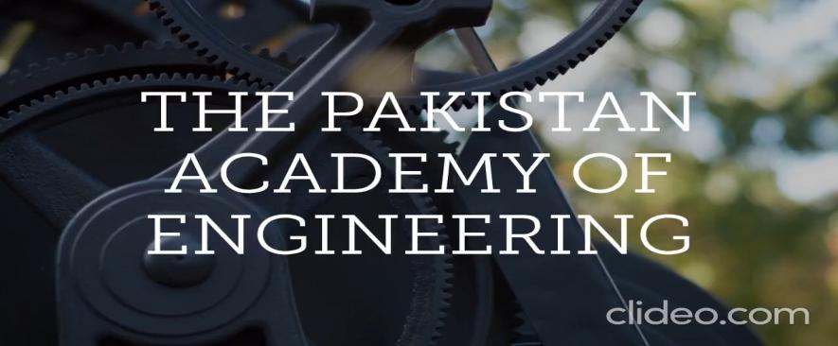
Video of PAE

